Slide 1

The Heart & Science of Communication in Family Business
Anil Sainani
Notes:
A very good morning everyone.
I, Simran Senani, consultant at our firm BAF consultants, welcome you all to our first webinar The Heart and Science of Communication in Family Business.
Thank you so much for taking out the time and attending this webinar.

Slide 2

Notes:
Now I am happy to give you a quick introduction to our firm BAF consultants.

Slide 3

We Facilitate Discovery, Creation & Implementation of Family Constitutions
Notes:
To us, Constitution
Why ? deal with the challenges and opportunities of living and working together
unwritten constitution.
Our core expertise
Now, implementation is far more difficult and challenging
implementation of their constitution.

Slide 4






















We Facilitate Discovery, Creation & Implementation of Family Constitutions
Notes:
Our team has worked with close to 150 Business families including some big business families like Godrej,GMR Group,Kirloskars, Dalmia Bharat Group, DCM Shriram, SRF and others.
We have also worked with smaller families and businesses with few members and turnover as less as 75-100 crores.

Slide 5
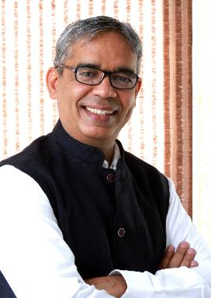
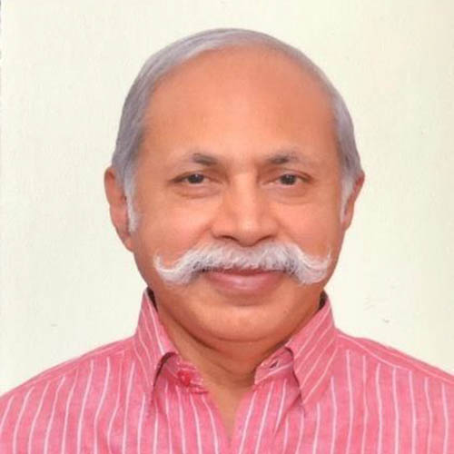
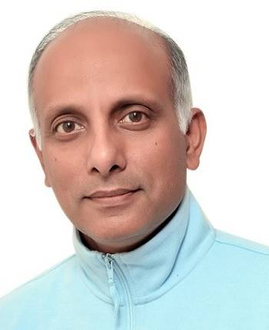
Key Members of BAF Team
Anil Sainani
Managing Partner
T D Chandrasekhar
Partner
Shailendra Agarwal
Partner
Notes:
Anil : own family’s constitution
Triumph of Togetherness
aligning family members even in most complex and difficult situations.
Mr. TD Chandrasekhar, an IIT Delhi and XLRI Jamshedpur alumni, ex PWC, NIIT, and Ex CEO Ameriprise - Indian Subsidiary of American Express is an Innovation consultant for leading organizations, where he focuses on making the culture conducive to creative solutioning.
He has coached over 100 executives, taken more than 750 senior executive workshops across 50 corporates and has spoken at more than 100 speaking engagements.
Mr Shailendra Agarwal , An alumnus of St Stephens College, and a student of psychology and management has worked as an IAS officer for 33 years in Government of Rajasthan, Government of India and in International organisations like WTO at Geneva, before retiring. He has been working in the area of family Governance for the last few years with us.

Slide 6
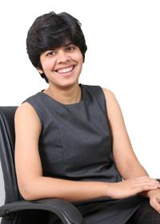
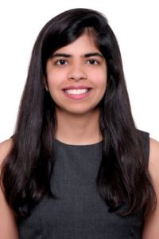
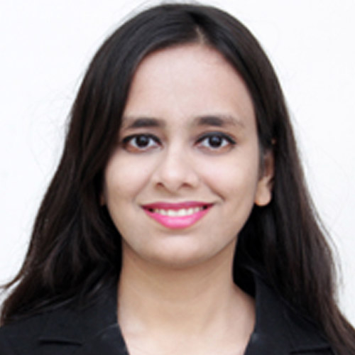
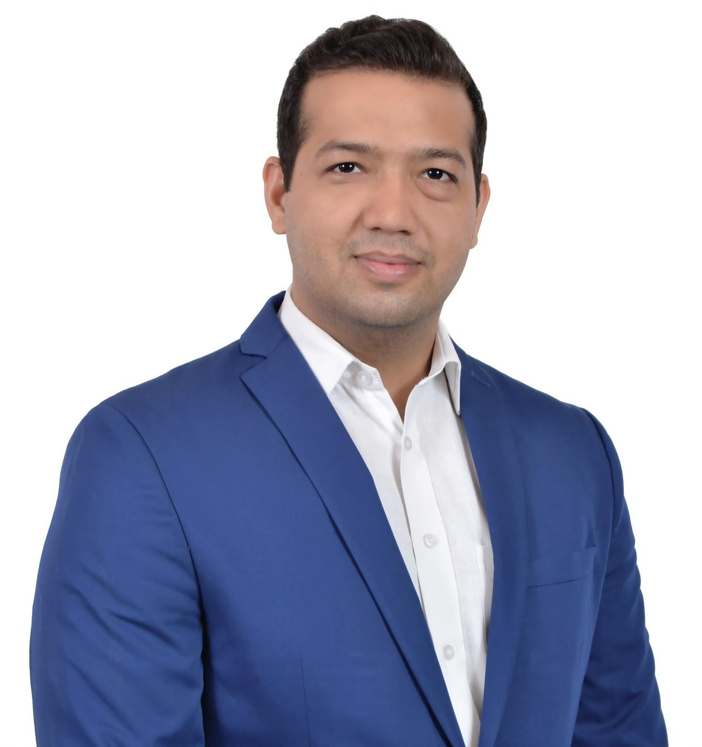
Key Members of BAF Team
Sidhya Senani
Chief Operations Officer
Sunil Soni
Senior Consultant
Simran Senani
Consultant
Rashi Manwani
Consultant
Notes:
They are supported by a capable team of professionals - Sidhya, MBA Oxford University , Sunil MBA Flame University and Rashi, graduated from Faculty of Management Studies, Symbiosis are goal-oriented professionals who are extremely committed to people development to support long-term sustenance.
Lastly I am Simran Senani , a lawyer and I have been fortunate to have been trained in Mediation and Negotiation Skills by one of the most experienced Mediators at the Supreme Court of India and also to have found my calling at the start of my career. I am deeply passionate about empathizing with family members of different families. I have been brought up in the Joint Business Family and belong to the 3rd generation of the Sainani family. I feel blessed to have grown immensely, in the personal as well as professional space while growing up in my joint family. I am devoted to creating such a space for members of other families. In pursuit of the we present to you this webinar. Without further ado i’d like hand over to Anil to begin the session.

Slide 7

Agenda of Any Workshop/Meeting
Notes:
comprehensively cover all human needs and endeavors

Slide 8


Agenda/Focus of Our Webinar
The Heart & Science of Communication in Family Business

Slide 9
Communication Challenges in Family
Aapko to bas kaam achaa lagta hai, meri koi importance nahin hai
Tumse to simple se cheezen bhi nahin hoti hain, aur expect karti ho ki household decisions me tumhari say ho
Family ke kharche din pe din badhte jaa rahe hain, mere baar baar kahne ke bawazood, kisika ka is par dhyaan hi nahi jata
I get zero support from my father and brother. We hardly talk to each other

Slide 10
Instances of Communication in Tough Business Issues
Dad, our company will go into NCLT
You don’t value my role in wealth creation in the business. I want to get separated
I want to sell 49% of my stake in family business, but my brother is neither giving me a fair price nor allowing me to sell it to an outsider
Thanks to my sister in law, my brother has become selfish. He wants to change one of our foundational principles of equal income for both of us

Slide 11
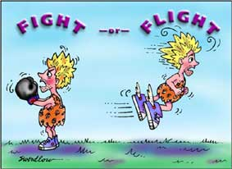

Slide 12
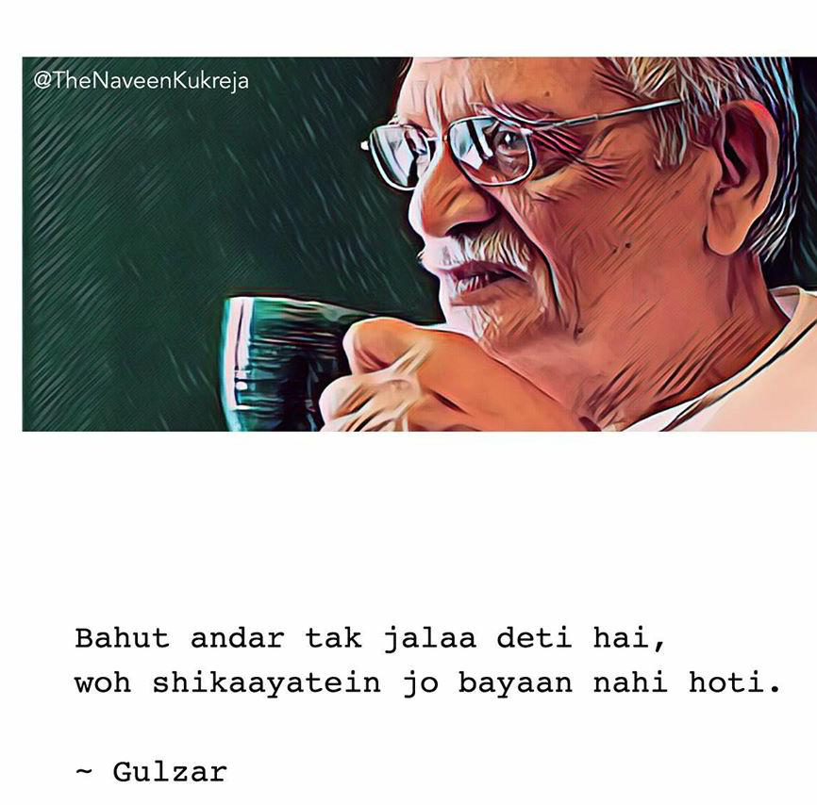

Slide 13

Agenda/Focus of Our Webinar
The Heart & Science of Communication in Family Business

Slide 14
Is duniya mein Sabse Zyada Di Jaane Wali Aur Sabse Kam Li Jaane Wali Cheez Ek hi Hai.
Kya Hai wo?

Slide 15
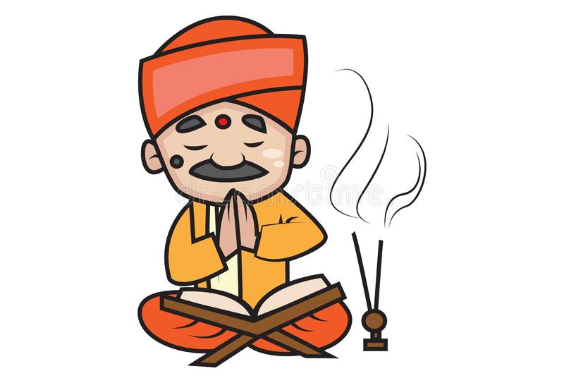

Purohit
Pandit

Slide 16

We believe all of you are wise
You have wisdom
In fact each human being is born with Wisdom

Slide 17

Making The Leap from Knowing/Prandit to Doing/Gyani
The Heart & Science of Communication in Family Business

Slide 18

After the good news on “Wisdom” let me share the bad news -
All of us also have “EGO” - The biggest enemy with us

Slide 19

Aapko toh bas kaam achaa lagta hai, meri koi importance nahin hai
Husband: Kaam kiske liye kar rahaa hun ?
Wife: Mere liye koi nahin kaam kar rahe ho. Kaam isliye kar rahe ho kyunki tumko kaam karne mein mazaa aata hai
Husband : At least kuch galat toh nahi kar rahaa, kaam hi toh kar rahaa hun
Wife : Kaise galat nahin kar rahe ho, aapko yaad bhi rahta hai ki kar par ghar par mein aur bacche aapka intezaar kar rahe hain
Husband : Tumko toh jitni importance mile utni kam padti hai
Wife : Khaak importance detein hain aap

Slide 20

Aapko toh bas kaam achaa lagta hai, meri koi importance nahin hai
Husband: Lagta hai maine phir tumhe takleef di hai
Wife: Sach mein mujhe bahut takleef hai. Taqleef hi nahin, mujhe gussa bhi aa raha hai
Husband : Lagta hai tum mujhse naraaz ho
Wife : Of course, aapne wada kiya tha ki 7 baaje tak aa jayenge aur jab maine saat baaje aapko phone kiya to aap office se nikle bhi nahin the. Aur ab 9 baje ghar aayen hain
Notes:
Ask people that hum ye karte kyu nahi hai ?
Das baar vaise baat karte hai aur ek baar aise ?

Slide 21
Aapko toh bas kaam achaa lagta hai, meri koi importance nahin hai
Husband: I am sorry
Wife: Aapki Sorry ka koi matlab nahin hai
Husband: Sweetheart, what can I do to make you happy? Shall we go out for coffee after dinner, you and me alone
Notes:
Ask people that hum ye karte kyu nahi hai ?
Das baar vaise baat karte hai aur ek baar aise ?

Slide 22
You don’t value my role in wealth creation. I want to get separated
Context:
Two brothers
Both managing separate businesses
Father is non-executive Chairman
Younger brother has been very successful,
Elder brother has lost money in business and his wife is spendthrift

Slide 23
You don’t value my role in wealth creation. I want to get separated
Father: Dhauns kisko dikha rahe ho
Son: Main koi dhauns nahin dikha raha hoon
Father : Jo karna hai karo, I am still the owner of the business
Son: Itni baar to aapse keh chuka hoon, par aapko meri baat samajh mein hi nahin aati hai

Slide 24
You don’t value my role in wealth creation. I want to get separated
Father : Abhi tumhara dimaag theek nahin hai
Son : Mein prem se kehta hun toh aapko samajh nahi aata hai, gusse mein kehta hun, tab bhi nahi aata hai, mein karu kya
Father: Yeh samjhdhari ki baatein tumhe kisne sikhai hai beta
Son: Mein koi bacchaa nahi hun jo kisi ki samajhane se chalun

Slide 25
You don’t value my role in wealth creation. I want to get separated
Father: Are you feeling hurt ? Are you angry?
Son: Haan mujhe gussa aa rahaa hai aur mein frustrated bhi hun
Father : Mere kis action ki wajah se tum aisa keh rahe ho beta ? Ya Bhai ne kuch kahaa hai?
Son : Bhaiya se zaada aapke kuch nahi karne se mujhe zyada problem ho rahi hai

Slide 26
You don’t value my role in wealth creation. I want to get separated
Father: Abhi baat karein ya shaam ko, tab tak shayaad aapka gussa bhi thanda ho jayega?
Son: Papa kal subah 7 baje baat karte hain

Slide 27
  Judge & Evaluate - Who is right?
  Wants more/greedy
  Fearful
  Humility - What is right?
  Content/ Abundance
  Faith

Slide 28


EGO

Slide 29

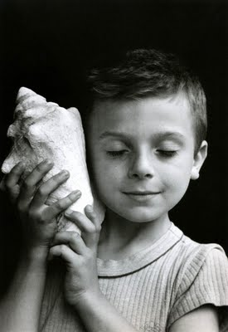

Wisdom

Slide 30
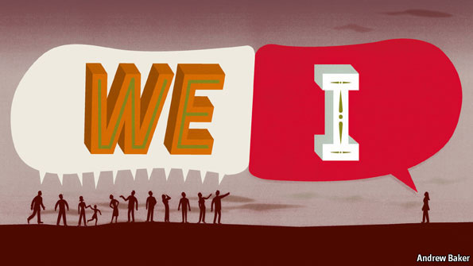

Slide 31
Communication Approaches in Two States
  I know the answer
  The other person just doesn’t understand
  The other person is responsible
  I cannot do this
  Beneath what is said, lie the feelings
  Only the person experiencing can tell what is the feeling
  Beneath each feeling, there is a need
  We can find a way that will fulfill need of both persons

Slide 32
5 Step Process for Communication in Wisdom
Step 1 : Check your feelings: Am I calm or agitated
Step 2 : Ask the other person “Aap kya mehsus kar rahe ho?” (Discover the feeling)
Step 3 : Tumhari konsi zarurat puri nahi ho rahi hai ? (Discover other person’s need)
Step 4 : Identify and share your need, if any
Step 5 : How can we cater to our needs ? (Discover the action for one or both persons) such that life becomes more fulfilling for both/all of us

Slide 33
Dad, our company will go into NCLT
Context:
Father Son working together in 1000 Cr. business
2nd son studying in US
Mother also present during conversations
Father is the CMD
Business is going through very tough challenges
The son holds father responsible for the same

Slide 34
Dad, our company will go into NCLT
Father: Why are you so afraid and fearful
Son: I am not afraid. But Dad we need to be realist
Father : You need to think positively
Son: You don’t see the facts, we are bleeding day in day out

Slide 35
Dad, our company will go into NCLT
Father : Your negative attitude de-energies me also
Son:You are putting the entire family to risk
Father To Mother : tum isko kuch samjhati kyon nahin ho?
Father: There is no point in our having this conversation
Son: Yes, there is no point in our having this conversation
Mom: (in her mind): Prabhu hame is mushkil se nikalo

Slide 36
Dad, our company will go into NCLT
Father: I may be wrong, but it seems you are really stressed?
Son: Dad you know this, yet you are asking? I am not only stressed but also fearful
Father: And again if I understand this correctly you are fearful that we will fail in turning around the company and that violates your need for Security
Son: Yes

Slide 37
Dad our company will go into NCLT
Father: Since we have different point of views on specific actions and we have not been able to convince each other, how do we deal with this situation
Son: I really don’t know. Do you think, we should seek help of a Board Member or a Family Business Coach?
Father: Sure! let’s both think on specific names and carry forward our conversation tomorrow morning

Slide 38
Tumse toh simple si cheeze bhi nahi hoti hain aur tum expect karti hai ki tumhari ghar ke decisions mein say ho
Context :
Two Daughters in law ( DIL) of the family
Elder DIL is very organised and socially active
Younger DIL is creative and an introvert
They talk to each other only on need basis

Slide 39
Tumse toh simple si cheeze bhi nahi hoti hain aur tum expect karti hao ki tumhari household related decisions mein say ho
Younger DIL : Aap kitni rude aur insensitive hain !
Elder DIL : Ek toh galti karo upar se jo kaam kar raha hai usse galiyaan do
Younger DIL : Itni si baat ko itna badaa banaana toh koi aapse seekhe
Elder DIL : Jab wohi galtiyaan hazaar baar dohraoge toh kya kya kare? Maine kabhi perfect hone kaa daava nahin kiya hai

Slide 40
Tumse toh simple si cheeze bhi nahi hoti hain aur tum expect karti hai ki tumhari household related decisions mein say ho
Younger DIL : Bhabhi meri is galti se shayad aapko bohot irritation ho raha hai
Elder DIL : Ye koi rocket science hai kya? Of course irritation ho raha hai aur gussa bhi aa rahaa hai
Younger DIL: Bhabhi mein aapki is feeling ke peeche aapki deeper need samajhna chahti hun
Elder DIL : Meri need hai hum sab as family members apni responsibilities nibhaaye jaise hum khushi se saath rah paaye

Slide 41
Tumse toh simple si cheeze bhi nahi hoti hain aur tum expect karti hai ki tumhari household related decisions mein say ho
Younger DIL: Bhabhi main aapse request karti hoon ki aap mujhe kuch dino ke liye home management ki training dein. Main vaada karti hoon ki aapki achi student banungi
Elder DIL : Sure sweetheart/ Tumne to mera din bana diya

Slide 42
Life and Conversations in Wisdom State
Puneet Dalmia at FBN
  He gave credit for success to everyone, other than himself
  Overall context …..Life is peaceful, impactful and happy
I love you sweetheart with every fibre of my body
Son you have not failed, you have learnt valuable lessons in entrepreneurship
When I think of my daughter, whatever be the difficulty I experience sense of peace and serenity
During each meltdown, few new extremely successful businesses emerge. I am on lookout for investing in them

Slide 43
Summarizing
Some Example of Communication Challenges in Family and Business
Igniting the inherent Wisdom within ourselves rather than talking about it
  Key Features of Ego and Wisdom
  Communication in the state of Ego and Wisdom
  5 Steps of Communication in Wisdom State and applying the same
Life and Conversations in Wisdom State

Slide 44
Key Takeaways
Remind yourself : We all have Wisdom and Ego within us
Prerequisite for effective communication : State of Wisdom
5 Step process to be followed in wisdom state
  Step 1 : Man ki shaanti
  Step 2 : Discover the feeling
  Step 3 : Discover other person’s need
  Step 4 : Identify and share your need, if any
  Step 5 : Discover the action for one or both persons

Slide 45


